Slide 1
Programming Fundamentals
Lecture 12

Slide 2
Objectives
Object Oriented Programming (OOP)
Data Modeling
Objects
Methods and functions
Classes
Implementing Classes in C++
Data Hiding
Creating instances of a class
The dot operator
Comparison between OOP and Procedural approaches
Difference between structures and classes

Slide 3
Object Oriented Programming (OOP)
Historically, a program has been viewed as a logical procedure that takes input data, processes it, and produces output data
The programming challenge was seen as how to write the logic rather than how to manipulate data
OOP refers to a type of computer programming (software design) in which programmers define the data type of a data structure, and also the types of operations (functions) that can be applied to the data structure
The first step in OOP is to identify all the objects the programmer wants to manipulate and how they relate to each other, an exercise often known as data modeling
The OOP revolves around Objects, Methods, Classes, Private and Public keywords

Slide 4
Objects
An object is a black box which receives and sends messages
An object is a component of a program that knows how to perform certain actions and how to interact with other elements of the program
  An object’s properties are what it knows
  And its methods are what it can do
A simple example of an object would be a “person”
  Name is considered a property of the person
  Walking or driving would be considered a method of the person

Slide 5
Methods
A method is an action that an object is able to perform
It is a code which gets executed when the message is sent to particular object
For example for an object “Human” the method is “Walking”
  A method is dependent and associated with a class
  We need objects to use a method
A function is a combination of instructions that are combined to achieve some result
  A function is independent and not associated with a class
  You can use this function anywhere in your code, and you don't need to have an object to use it

Slide 6
Classes (1/3)
A class is a definition of objects of the same kind
In other words, a class is a blueprint, template, or prototype that defines and describes the static attributes and dynamic behaviors common to all objects of the same kind
  Static attributes it can be seen only within a file where it's defined
  Dynamic attributes are shared with all objects
Objects are commonly called the instances of the class
All the instances of a class have similar properties

Slide 7
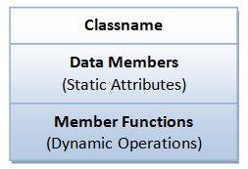
Classes (2/3)
A class can be visualized as a three-compartment box, as illustrated
  Classname (identifier)
    Identifies the class
  Data Members/Variables (attributes/states/fields)
    Contains the static attributes of the class
  Member Functions (methods/behaviors/operations)
    Contains the dynamic operations of the class

Slide 8
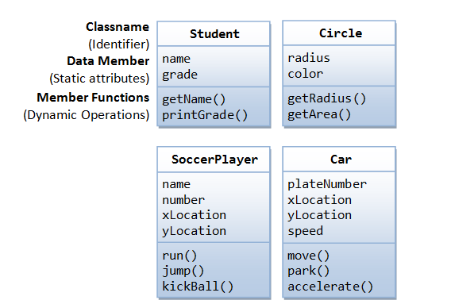
Classes (3/3)

Slide 9
Practice Problem 1
You know that Object Oriented Programming revolves around Objects, Classes and Methods. So before writing the code of any task in OOP the first step is data modeling
Consider that you want to design a program for the library of FAST
So you need to take care of Students, Library Staff, Books, Faculty and Furniture available in the library in order to code it
Your task is to identify class(es), Objects along with attributes and methods in this particular example

Slide 10
Practice Problem 2
Suppose that you are coding a cricket game. For this purpose you need to take care of players, ground, crowd, equipment (bat, ball, stumps etc) and Umpires. This task is too difficult with structural programming, thats why we need to go for Object Oriented Programming. So as a first step we will perform data modeling. Identify:
  Class(es)
  Object(s) in each class
  Attribute of objects of each class
  Method(s) of each object of every class

Slide 11
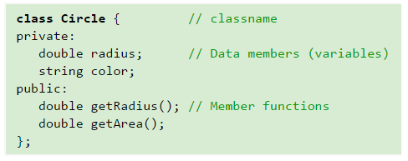
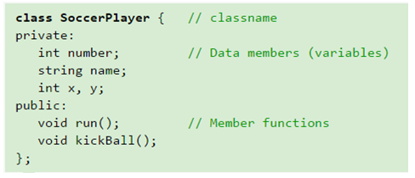
Class Definition
In C++, we use the keyword class to define a class

Slide 12
Private and Public Keyword
A key feature of OOP is data hiding
It means that data is concealed within a class. So that it cannot be accessed mistakenly by functions outside the class
Private data or functions can only be accessed from within the class
Public data or functions, are accessible from outside the class

Slide 13
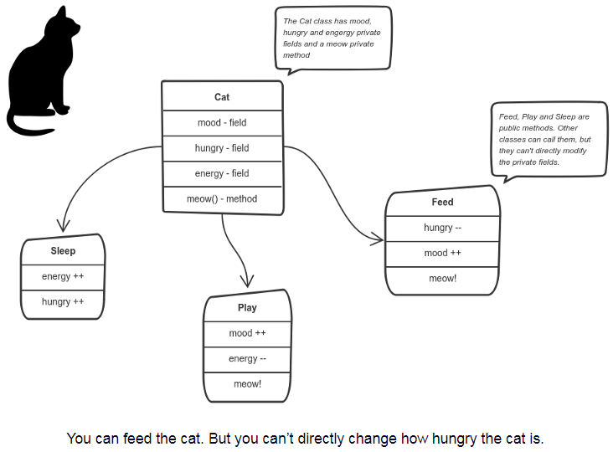
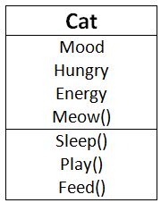
Why we Need Data Hiding?
You can’t directly change how hungry the cat is
The other classes can’t tell the cat when to meow

Slide 14
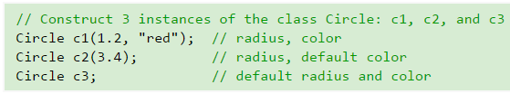
Creating the “instances” of a Class
To create an instance of a class, you have to:
  Declare an instance identifier (name) of a particular class
  Allocate storage for the instance and initialize the variables

Slide 15
Dot (.) Operator
To reference a member of an object (data member or member function), you must:
  First identify the instance you are interested in, and then
  Use the dot operator (.) to reference the member, in the form of instanceName.memberName
Course PF, LCA, BME;
PF.getgpa();
LCA.getpga();
BME.getgpa();
PF.showgpa();
LCA.showgpa();
BME.showgpa();

Slide 16
Object Oriented vs. Procedural Programming
Object Oriented
  Breaking the program in methods
  Every method performs the complete processing of data
  No back and forth movement of data
  Smooth flow of program
Objects + Messages = Program
Procedural
  Breaking the program in functions
  Each function processes the data little bit
  Data passes back and forth to functions
  Large programs becomes very complex
Data Structure + Algo = Program

Slide 17
Structure and Class
Structures
Classes
The members are public by default
It is value type (the variables are stored on stack)
Structure variables cannot be initialized directly
It does not support inheritance
The members are private by default
It is reference type (the objects are stored on heap)
Objects can be initialized directly
It supports inheritance

Slide 18
Implementing OOP in C++
Define the class
Declare the private variables
Define the dynamic behavior (public functions)
In main() declare objects
Call the functions through created objects
Look at the file name “basic_class_gpa” for example

Slide 19
Practice Problem 3
Modify the given program “basic_class_gpa” in such a way that it ask the user to enter the gpa in a course, then convert it to an equivalent grade and finally display the grade and GPA
Here is the mapping for Grades and GPA
  A 4.00 A- 3.67 B+ 3.33
  B 3.00 B- 2.67 C+ 2.33
  C 2.00 C- 1.67 D+ 1.33
  D 1.00 F 0.00
The solution is attached with file name “basic_class_gpa_modified”

